Slide 1
TRACKCARE: The GPS Safety System for Memory Support
A Compact, Automated, and Cost-Effective Solution for Health, Safety and Asset Monitoring

Slide 2
Team members
GOVIND H - AM.EN.U4ARE22023
HAMNA HAKKIM - AM.EN.U4ARE22024
ADITHYA POTHULA - AM.EN.U4ARE22026

Slide 3
INTRODUCTION
What is TRACKCARE?
TRACKCARE is an innovative safety and monitoring system designed to provide peace of mind for caregivers and individuals in need of constant care. Leveraging advanced technologies such as GPS, GSM, and motion sensors.
TRACKCARE ensures:
Real-time location tracking.
Automated emergency alerts.
Comprehensive safety monitoring.
Why TRACKCARE?
In an era where personal safety and health monitoring are paramount, TRACKCARE fills the gaps left by existing solutions. It is compact, affordable, and automated—addressing critical needs for those with memory-related challenges or at risk of accidents.

Slide 4
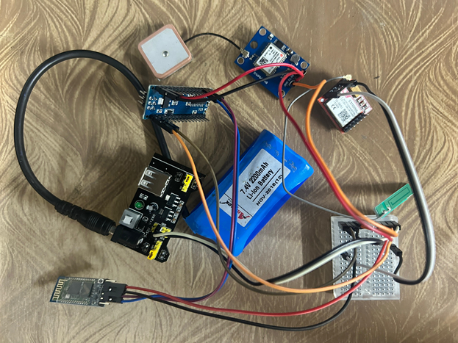
Components Used
Neo 6M GPS Module: For location tracking.
800L GSM Module: Enables messaging and calling.
5-10V Battery: Powers the system.
Arduino Nano: Central microcontroller.
HC05 Bluetooth Module: For optional wireless connectivity.
MPU 6050 Sensor: Detects motion, tilt, and acceleration.
Buzzer/Speaker: Plays a pre-recorded message for alerts.

Slide 5
Functionality
Fall and Accident Detection:
The MPU 6050 sensor detects abnormal motion or falls.
Automatically sends an alert in case of a crash or fall.
2. Automated Alerts:
Sends messages or calls emergency numbers (e.g., 100, 108).
Plays a pre-recorded message through the speaker or buzzer.
3. Anti-Theft System:
Can be attached to inanimate objects like cars to prevent theft.
4. Target Users:
People with Alzheimer's or in need of constant care.
Children for safety monitoring.

Slide 6
Market Analysis
Existing Systems:
Require Bluetooth connection with another device for full functionality.
Restricted to fitness tracking subsystems.
High cost, making them less accessible.
Lack automation for messaging, calling, or playing alerts.
Our Solution:
Compact and easy-to-carry design.
Fully automated without dependency on additional devices.
Cost-effective and accessible to a wider audience.

Slide 7
How It Works
Compact Form Factor:
Designed to be wearable or attachable to a belt.
Network Independence:
GSM modules directly connect to network stations without additional activation.
Real-Time Tracking:
GPS updates location every 5Hz (1/5th of a second).
Automated Actions:
Alerts triggered by sensor data for emergencies or theft.

Slide 8
Scope of Application
Primary Use Cases:
Health monitoring for individuals requiring care.
Child safety tracking.
Additional Applications:
Crash detection and immediate emergency response.
Anti-theft for vehicles and other valuable assets.

Slide 9
Future Additions
Dynamic Position Mapping:
Data from the GPS module will be stored in a server database for real-time tracking.
Enhanced Communication Range:
Integration of LoRa modules, Wi-Fi, and GSM for a high-low-high range communication system.
Expanded Functionality:
Adding features for broader safety and monitoring applications.

Slide 10
Conclusion
Innovative and Practical:
Combines safety, automation, and affordability.
User-Centric Design:
Tailored for diverse use cases, from health monitoring to theft prevention.
Future-Proof:
Scalable with advanced technologies for enhanced capabilities.

Slide 11
Thank you

